Slide 1
Selenium
DevOps

Slide 2

DEVOPS TESTING AUTOMATION - Selenium

Slide 3
Frequent regression testing
Rapid feedback to developers
Virtually unlimited iterations of test case execution
Finding defects missed by manual testing

Slide 4
1
Selenium is a suite of testing automation tools used for Web-Based applications: Selenium IDE, Selenium RC, Selenium WebDriver and Selenium Grid.
2
These tools provide a rich set of testing functions specifically geared to varied testing scenarios of all types of Web applications.
3
The operations provided by these tools are highly flexible and afford many options for comparing UI elements to expected application behavior
4
Selenium tests can be executed on multiple browser platforms

Slide 5
Headline statement
Selenium Suite
Selenium IDE
Selenium 2 (Webdriver & RC)
Selenium Grid
Selenium IDE (Integrated Development Environment) is a prototyping tool for building test scripts.
Detailed statement
WebDriver is designed in a simpler and more concise programming interface along with Selenium-RC API.
A Grid consists of a single Hub, and one or more Nodes to distribute tests.

Slide 6
SELENIUM IDE

Slide 7
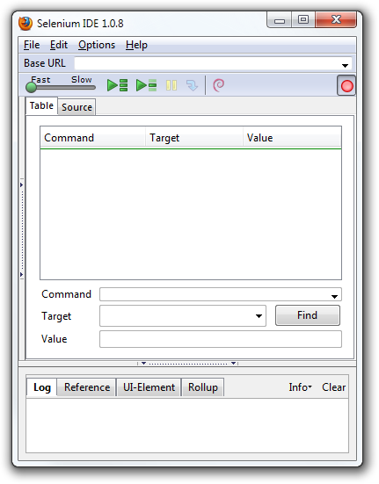
SELENIUM IDE
The Selenium-IDE (Integrated Development Environment) is the tool you use to develop your Selenium test cases. It’s an easy-to-use Firefox plug-in and is generally the most efficient way to develop test cases.

Slide 8
SELENIUM IDE TOOLBAR

Slide 9
SELENIUM IDE TOOLBAR
Record: Records the user’s browser actions.
Step: Allows you to “step” through a test case by running it one command at a time. Use for debugging test cases.
Pause/Resume: Allows stopping and re-starting of a running test case.
Run: Runs the currently selected test. When only a single test is loaded this button and the Run All button have the same effect.
Run All: Runs the entire test suite when a test suite with multiple test cases is loaded.
Speed Control: controls how fast your test case runs.

Slide 10
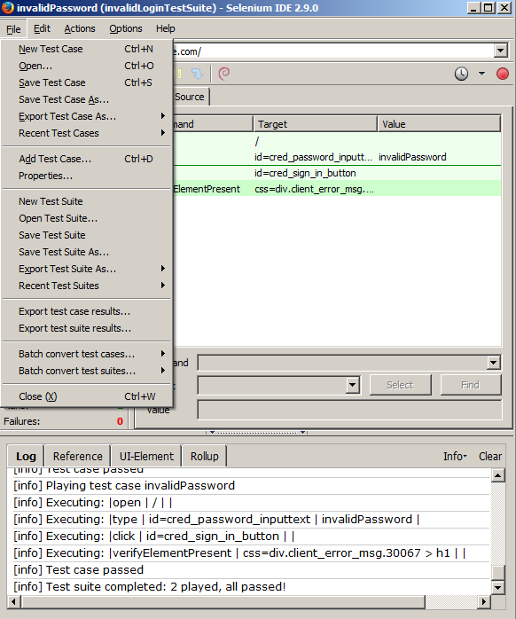
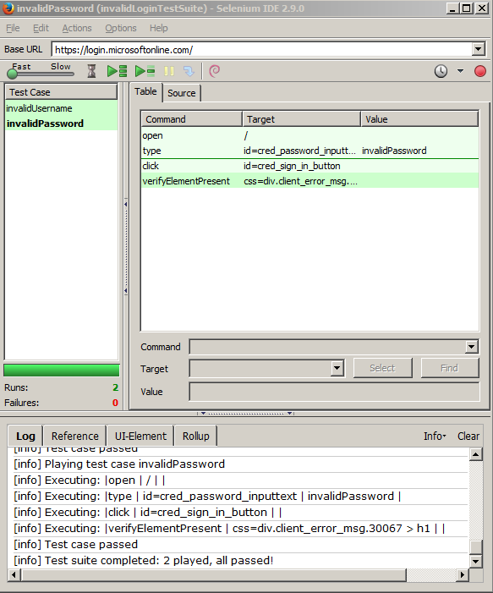

Slide 11
EXPORTED TEST SUITE RESULTS

Slide 12
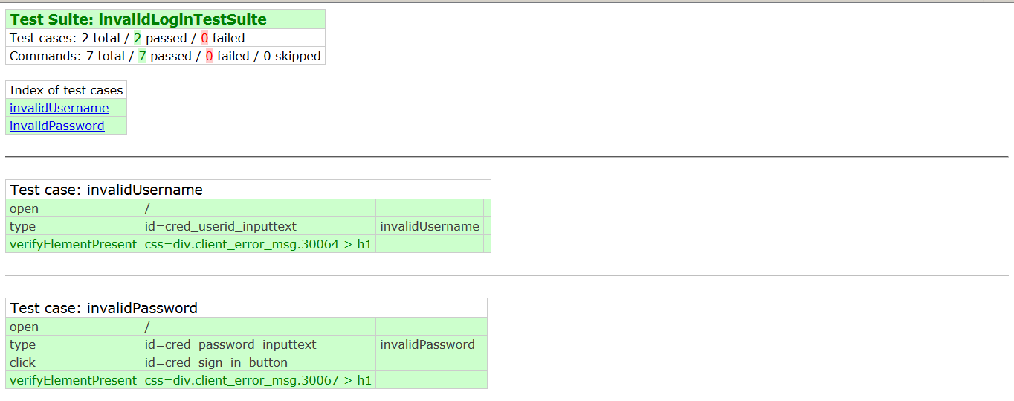
EXPORTED TEST SUITE RESULTS

Slide 13
SELENIUM WEBDRIVER

Slide 14
SELENIUM WEBDRIVER
WebDriver is designed to provide a simpler, more concise programming interface in addition to addressing some limitations in the Selenium-RC API.
WebDriver’s goal is to supply a well-designed object-oriented API that provides improved support for modern advanced web-app testing problems.

Slide 15
Drivers

Slide 16
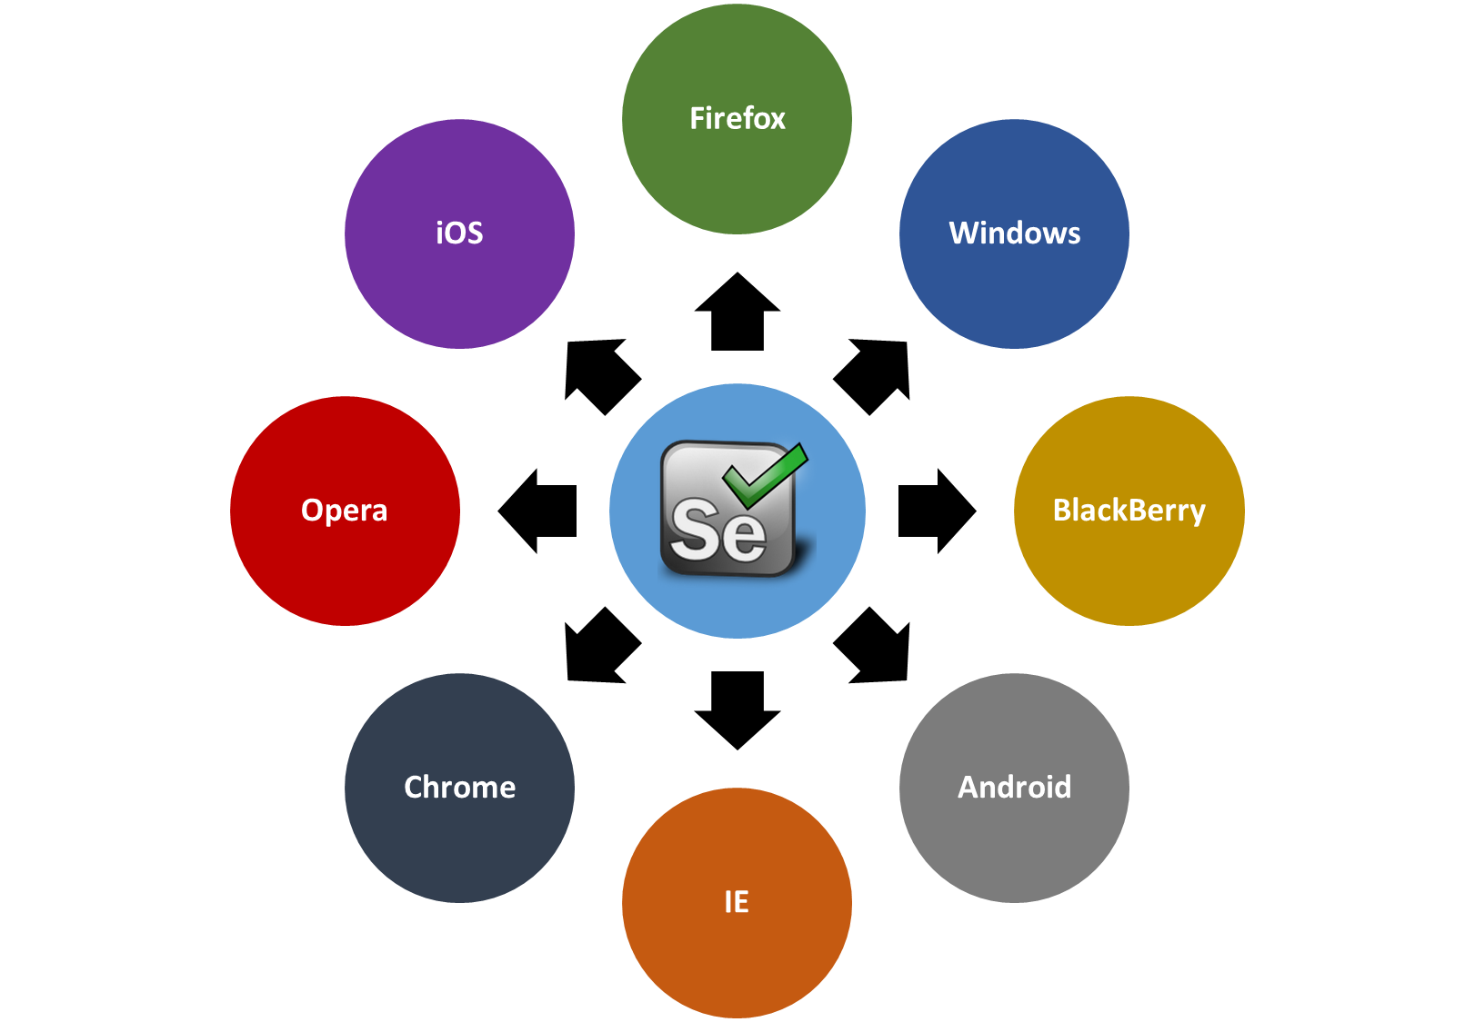
Drivers

Slide 17
SELENIUM GRID

Slide 18
SELENIUM GRID
Selenium-Grid allows you run your tests on different machines against different browsers in parallel. That is, running multiple tests at the same time against different machines running different browsers and operating systems. Essentially, Selenium-Grid support distributed test execution.

Slide 19
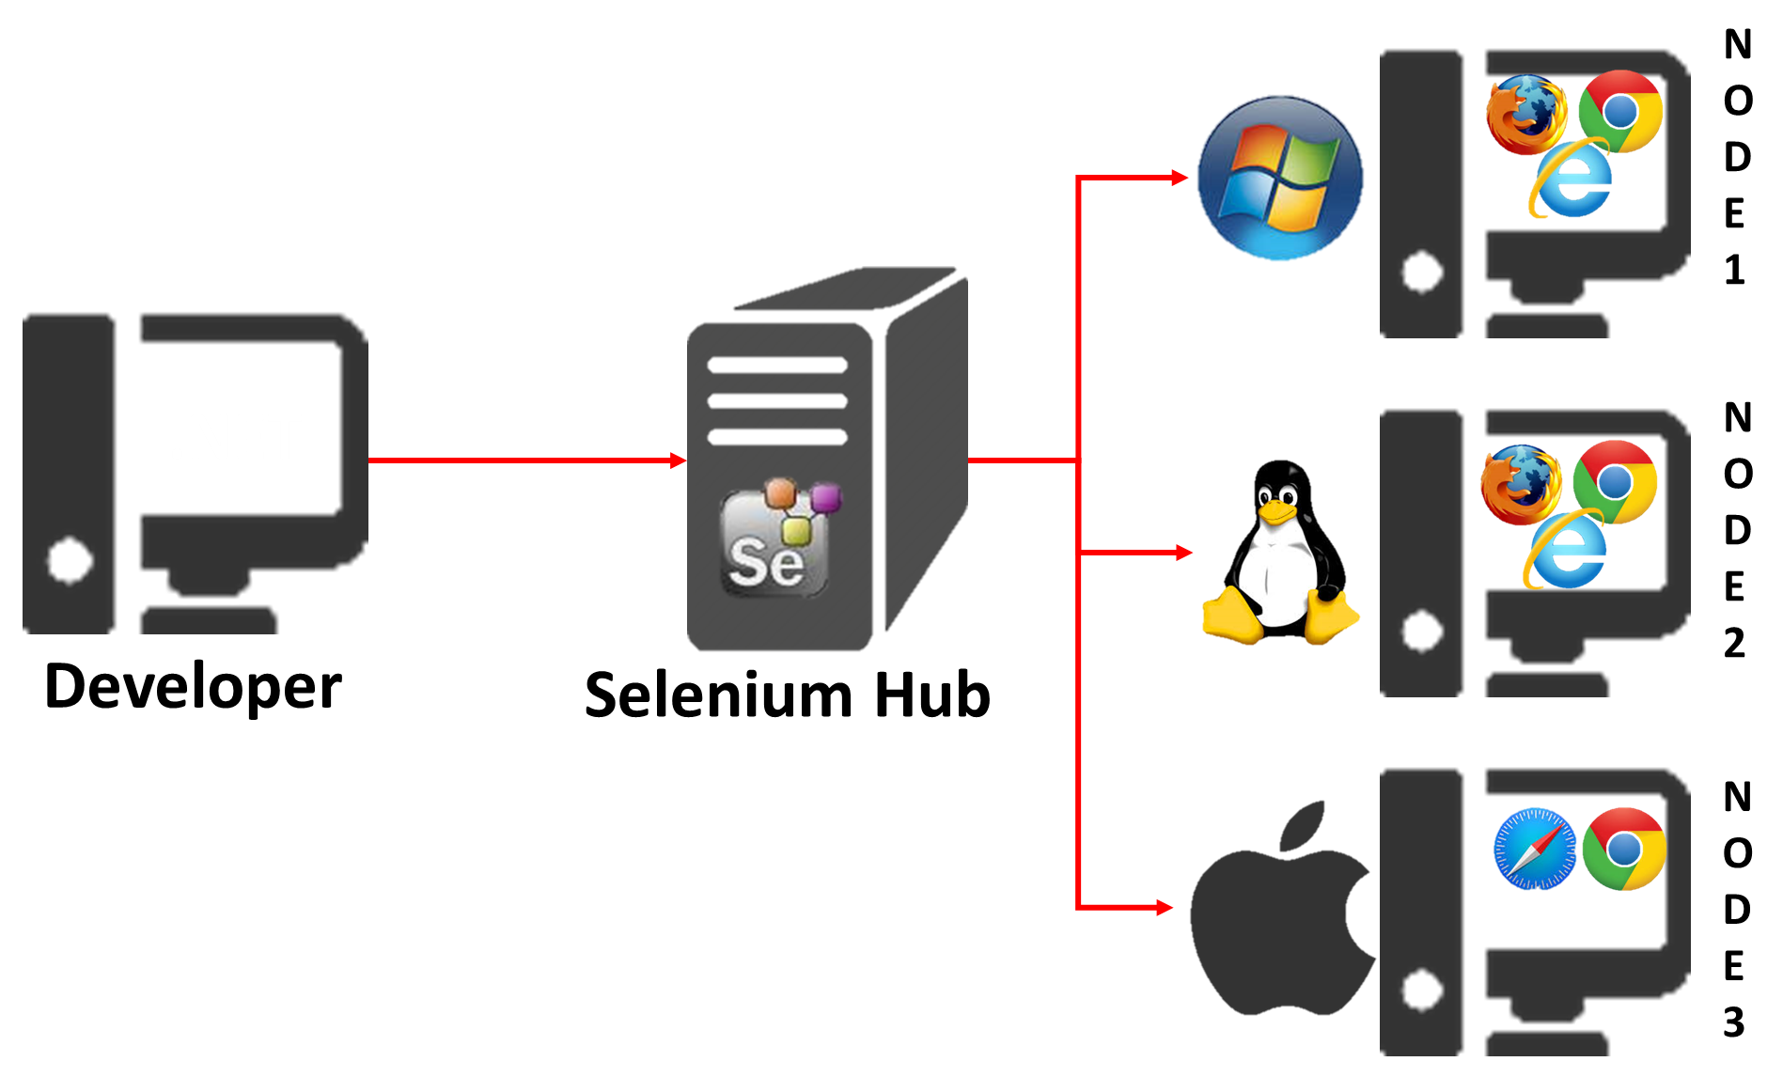

Slide 20
Reference

Slide 21
Reference
http://www.seleniumhq.org/

